Slide 1

K.J. Somaiya School of Engineering
Patient Records &
Urinalysis Workflow
UroScan AI
Browser-based academic prototype using simulated data
Computer Engineering / Second-year B.Tech Mini-project
Om Rode
Asmit Samanta
Rudraksh Sahane
16010125212
16010125221
16010125217
UroScan AI / Healthcare Group 3
01
Notes:
Our group developed a browser-based prototype for patient records and a simulated urine-test workflow. The working title is editable. The website itself is branded UroScan AI, but this version does not contain a trained AI model.
Source evidence: Project HTML titles and prior recorded user details. Screenshots are actual local browser captures from the provided source, using synthetic demonstration records where patient information is shown. No clinical accuracy is claimed.

Slide 2
Project context and problem
A connected record for each patient and test
Workflow problem
Proposed solution
Patient details, test status and reports need a clear, linked place in the interface.
A multi-page website that demonstrates patient registration, simulated testing and report review.
Intended users
Laboratory staff and pathologists represented through local demo accounts
UroScan AI / Healthcare Group 3
02
Notes:
The project demonstrates how a laboratory-style website can keep a patient record connected to a test and its report. The motivation is an organized workflow, not a proven improvement in medical outcomes. Intended users represented by the interface include laboratory staff and pathologists.
Source evidence: home.html; patients.html; new-test.html; reports.html. Screenshots are actual local browser captures from the provided source, using synthetic demonstration records where patient information is shown. No clinical accuracy is claimed.

Slide 3
Objectives and project scope
01
Organize patient records
02
Demonstrate a test journey
Register patients and find records by name or ID.
Select a patient and follow a timed simulation.
03
Present linked results
04
Retain local records
Display ten analytes, notes and a report for each test.
Save records in browser storage for later viewing.
Scope: frontend prototype. AI analysis, physical sensing and a backend are future work.
UroScan AI / Healthcare Group 3
03
Notes:
Explain these as objectives demonstrated by the delivered website. Patients and reports persist in the same browser. The diagnostic result is generated from fixed sample values, not measured from a urine strip. Accounts provide a local sign-in demonstration without secure server-side authentication.
Source evidence: js/app.js; js/patients.js; js/mockData.js; test-processing.html. Screenshots are actual local browser captures from the provided source, using synthetic demonstration records where patient information is shown. No clinical accuracy is claimed.

Slide 4
Technology stack
HTML5 + CSS
Pages, forms, tables, styling, Flexbox and Grid
JavaScript + jQuery 3.7.1
Input handling, search, navigation and DOM updates
Chart.js
Dashboard, patient-trend and analytics charts
Font Awesome 6.4.2
Interface icons
localStorage + JSON
Records retained in the same browser origin
No backend, database server, diagnostic API or AI model is included in the ZIP.
UroScan AI / Healthcare Group 3
04
Notes:
HTML creates page structure. CSS supplies appearance and layout. JavaScript controls behaviour, with jQuery helping events and page updates. Chart.js draws charts. Font Awesome supplies icons. JSON converts JavaScript objects to text for localStorage. External links deliver libraries, not patient data.
Source evidence: All HTML dependency tags; css/style.css; all ten js files. Screenshots are actual local browser captures from the provided source, using synthetic demonstration records where patient information is shown. No clinical accuracy is claimed.

Slide 5
Actual system architecture
Inside the browser
HTML pages + CSS
JavaScript + jQuery
localStorage
Forms and page layouts
Events and shared data helpers
JSON records on this browser
Page links carry patientId or test id. Each page reloads the relevant stored records.
External library CDNs
Browser-generated output
jQuery, Chart.js and icons
HTML report file and print dialog
Libraries load into the page
No clinical-data API or server database
UroScan AI / Healthcare Group 3
05
Notes:
Everything shown inside the browser runs on the user’s computer. Separate HTML pages load shared scripts. Those scripts read and write JSON strings in localStorage. Links pass patient and test IDs in the URL. Reports are built in the browser as HTML. A local HTTP server used during testing only served static files and is not a project backend.
Source evidence: js/app.js; js/mockData.js; js/test.js; js/results.js; js/reports.js. Screenshots are actual local browser captures from the provided source, using synthetic demonstration records where patient information is shown. No clinical accuracy is claimed.

Slide 6
Website workflow
Sign in
Choose patient
Start test
Local account
Directory or new record
Save selected patient
Continue from “Start test” to “Simulated processing”
Simulated processing
Results and notes
Report
Preset values saved
Review interface
View, export or print
The report is created when the test is saved. Review updates that existing record.
UroScan AI / Healthcare Group 3
06
Notes:
Sign in or register a local account, create or choose a patient, and start the simulation. Processing saves a test and matching report before review. Results display the saved values. Submitting notes updates both test and report, but the current dropdown integration always saves Approved. The report can then be viewed and exported.
Source evidence: index.html inline script; js/test.js; test-processing.html inline script; js/mockData.js: saveTest and updateTestReview. Screenshots are actual local browser captures from the provided source, using synthetic demonstration records where patient information is shown. No clinical accuracy is claimed.

Slide 7
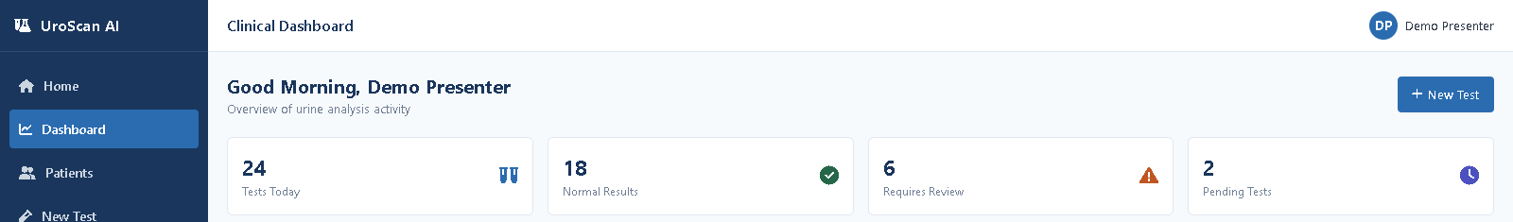
Home, navigation and dashboard
Dashboard header and sample summary cards
Working navigation
Mixed data sources
Home, Dashboard, Patients, New Test, Reports, Analytics and Device Status.
The recent-test table uses stored records. The summary cards and activity chart are fixed examples.
Displayed dashboard totals are sample values, not live activity statistics.
UroScan AI / Healthcare Group 3
07
Notes:
Home describes the proposed platform and its concept. The sidebar links to the main modules. The dashboard recent-test table reads stored tests and its status filter worked in the earlier browser check. The cropped screenshot shows fixed summary cards only, avoiding uncertain seeded patient identities. The numbers are illustrative and are not measured project results.
Source evidence: home.html; dashboard.html; js/dashboard.js; previous browser audit. Screenshots are actual local browser captures from the provided source, using synthetic demonstration records where patient information is shown. No clinical accuracy is claimed.

Slide 8
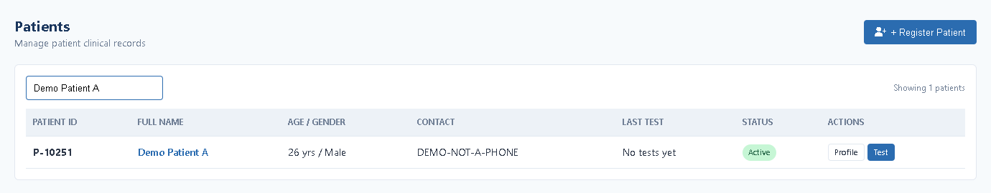
Patient registration and search
Actual website capture: synthetic patient record found by name
01
Register
02
Continue the workflow
Basic required fields and DOB-based age calculation.
Open patient history or start a test for this patient.
UroScan AI / Healthcare Group 3
08
Notes:
A synthetic patient called Demo Patient A was created through the actual registration form. The earlier browser check confirmed that the patient remained after reloading. Search finds patient names and IDs, and Profile/Test links pass the selected patient to other pages. Profiles show saved history. An empty profile currently displays sample trend data, which is a limitation.
Source evidence: patients.html; js/patients.js; js/patient-profile.js; previous browser audit. Screenshots are actual local browser captures from the provided source, using synthetic demonstration records where patient information is shown. No clinical accuracy is claimed.

Slide 9
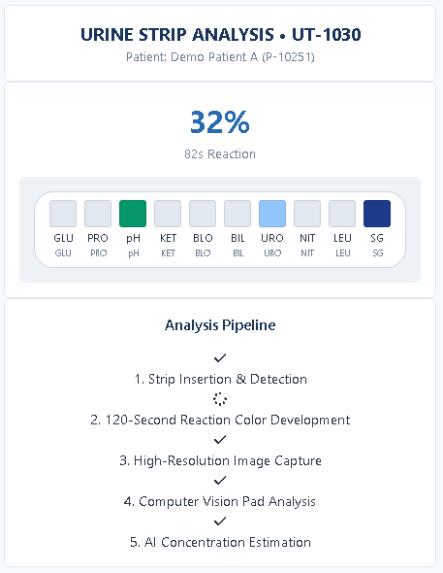
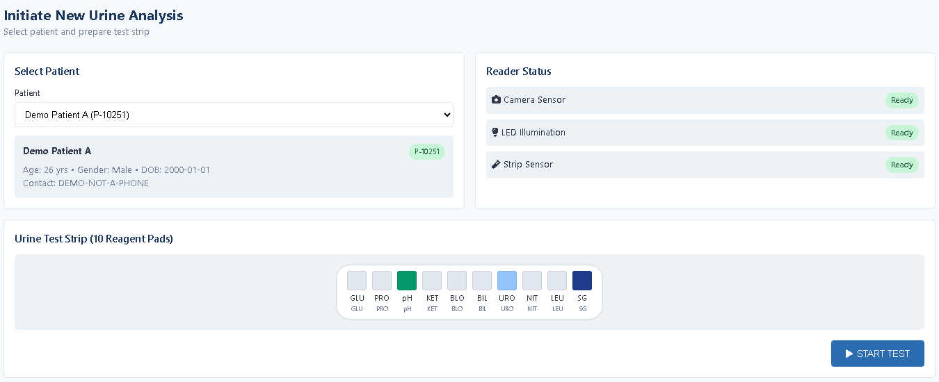
Test setup and simulated processing
Patient selection and test initiation
The interface simulates strip processing.
It does not measure a physical sample.
Timed demonstration
UroScan AI / Healthcare Group 3
09
Notes:
The selected patient is carried to new-test.html through a URL parameter. Clicking Start Test stores current-test metadata. Processing advances by 4 percent every 350 milliseconds and then saves constant results. Its countdown labels describe a 120-second concept, but the code runs a much shorter simulation. No camera image is captured.
Source evidence: js/test.js; test-processing.html:103–186; previous browser audit. Screenshots are actual local browser captures from the provided source, using synthetic demonstration records where patient information is shown. No clinical accuracy is claimed.

Slide 10
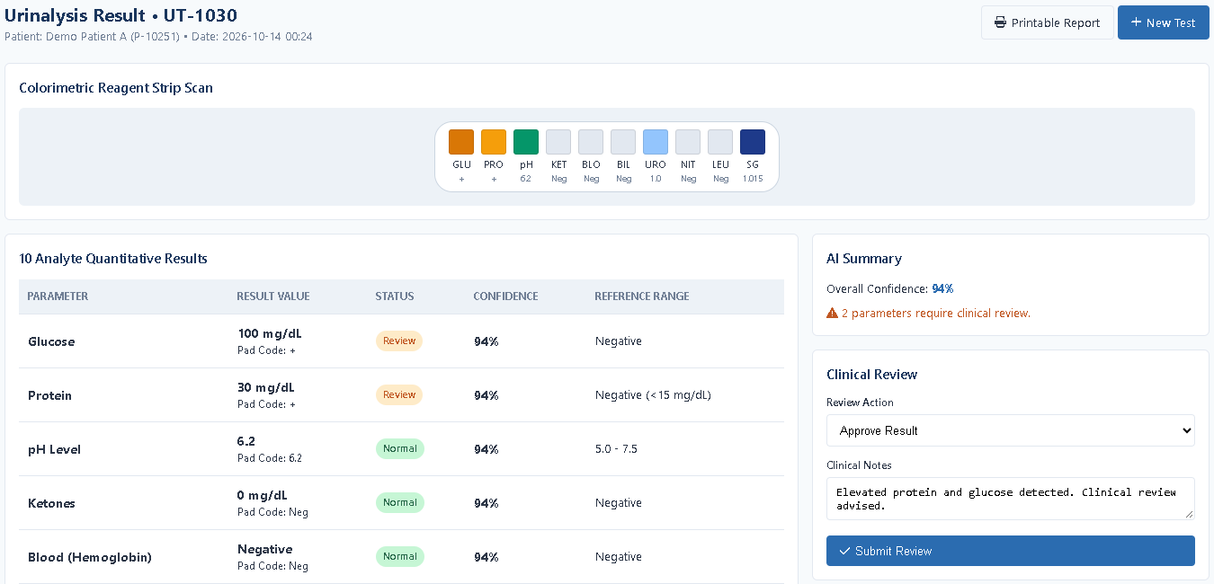
Results and review interface
Preset result values and 94% confidence. Review options currently save as Approved.
UroScan AI / Healthcare Group 3
10
Notes:
The result page shows ten stored analytes including glucose, protein, pH and specific gravity. Each new simulated test has the same values and 94 percent confidence, so this number is a preset label rather than measured AI accuracy. The screenshot is a cropped extract. The review dropdown offers options, but the JavaScript reads a missing button group and defaults to Approved. Notes do persist.
Source evidence: results.html; js/results.js; test-processing.html generatedTest; runtime check of Request Retest. Screenshots are actual local browser captures from the provided source, using synthetic demonstration records where patient information is shown. No clinical accuracy is claimed.

Slide 11
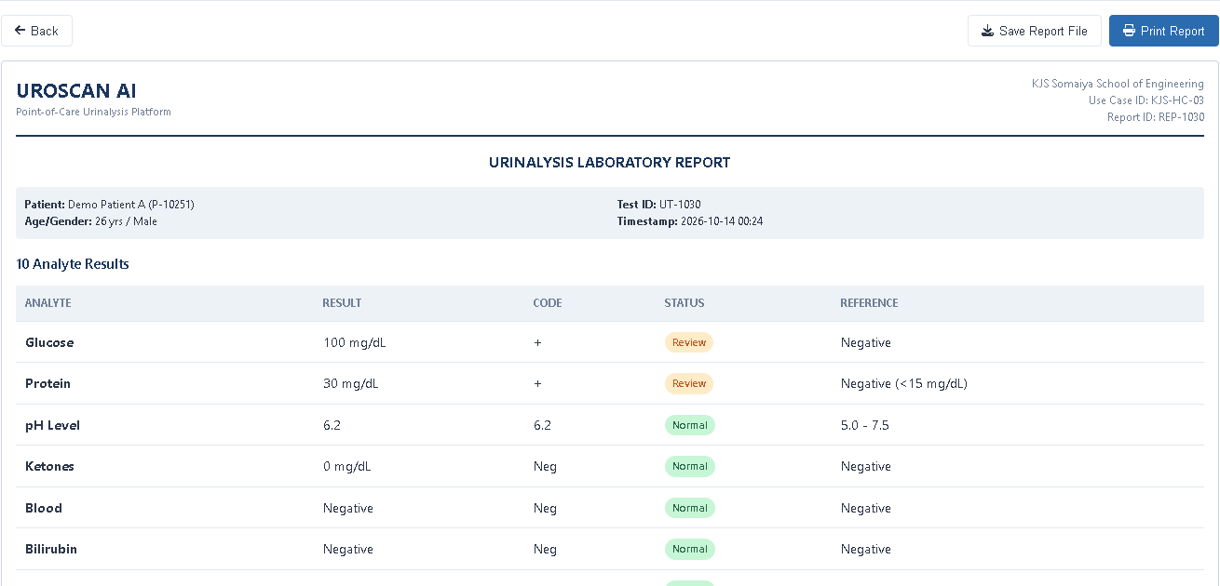
Reports and local export
Linked archive
Patient, test and report identifiers connect the records.
Output formats
HTML file download and the browser print dialog.
Actual report extract using a synthetic patient
The exported report identifies the system as an Academic prototype using simulated data.
UroScan AI / Healthcare Group 3
11
Notes:
saveTest creates a matching report in localStorage. The archive can search by patient, test or report identifiers. The screenshot shows a synthetic report extract. Save File generates an HTML document, and Print Report invokes browser printing. Earlier checks confirmed HTML generation and a later isolated download, but no medical validation or full print-output verification is claimed.
Source evidence: js/mockData.js: saveTest, saveReport, downloadReportFile; js/reports.js; earlier runtime observations. Screenshots are actual local browser captures from the provided source, using synthetic demonstration records where patient information is shown. No clinical accuracy is claimed.

Slide 12
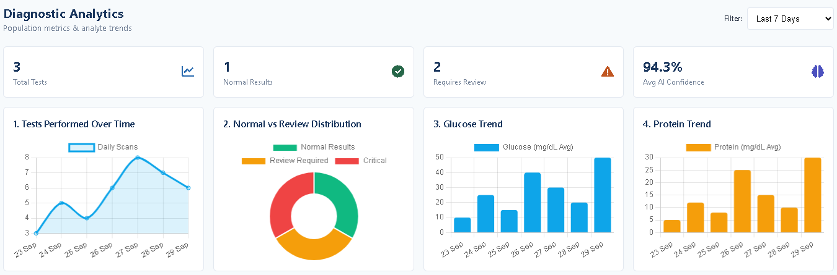
Analytics and device demonstration
Analytics screenshot: sample visualizations, not clinical performance evidence
Analytics
Device
Counts partly computed; date ranges and charts need correction.
Camera and LED checks are timed UI simulations.
UroScan AI / Healthcare Group 3
12
Notes:
Analytics calculates some counts from stored tests, but most plotted series are hardcoded. The range selection slices a number of records instead of filtering dates. Missing chart canvases produced errors in browser checks. Device buttons only wait and change text, with no camera or Raspberry Pi connection. Do not present the graph or device labels as live measurements.
Source evidence: js/analytics.js; analytics.html; device.html; js/device.js; earlier runtime errors. Screenshots are actual local browser captures from the provided source, using synthetic demonstration records where patient information is shown. No clinical accuracy is claimed.

Slide 13
Implementation and verified behaviour
Implementation highlights
Observed in browser checks
Shared data helpers
JSON records in localStorage
URL IDs link pages
jQuery updates page content
✓ Local registration and sign-in
✓ Patient retained after reload
✓ Patient and report searching
✓ Simulation saves 10 analyte rows
Issues also reproduced
✓ Notes update the linked report
Retest saved as Approved.
Analytics raised chart errors.
Evidence supports a browser demonstration, not diagnostic accuracy or production readiness.
UroScan AI / Healthcare Group 3
13
Notes:
The strongest implementation is the connected local workflow. These observations come from the previous browser checks and source review. Do not call this a complete automated test suite or clinical validation. Syntax checks covered ten standalone JavaScript files and two embedded scripts. The review defect and analytics errors were observed, not hypothetical.
Source evidence: js/app.js; js/mockData.js; previous js-check-results.json; runtime/partial-results.json; runtime/remaining-results.json; runtime-followup/observations.json. Screenshots are actual local browser captures from the provided source, using synthetic demonstration records where patient information is shown. No clinical accuracy is claimed.

Slide 14
Limitations and future scope
Current limitations
Next steps
Local demo login and browser-only records
Add secure backend and database storage
Preset test values and device status
Integrate real measurements and validation
Review, chart and test-ID defects
Fix review wiring, charts and unique IDs
Sample trends appear for empty histories
Use truthful empty states and computed metrics
Future capabilities require implementation and testing before they can be claimed.
UroScan AI / Healthcare Group 3
14
Notes:
The next step should first repair the current frontend defects. For real deployment, the system would need server-side authentication, permission checks, a database and safer data handling. Hardware integration and validated diagnostic models would be separate future engineering work. None of those components are delivered in this ZIP.
Source evidence: Verified source limitations in js/app.js, js/test.js, js/results.js, js/analytics.js, js/patient-profile.js. Screenshots are actual local browser captures from the provided source, using synthetic demonstration records where patient information is shown. No clinical accuracy is claimed.

Slide 15
Conclusion
A connected patient-to-report workflow
The project demonstrates patient records, test simulation, result display and local reporting in a browser.
The technical learning
Page structure, interface styling, event handling and persistent local data
Repo Link:
https://github.com/Asmit-64bit/Healthcare_grp_3
UroScan AI / Healthcare Group 3
15
Notes:
Our group built a frontend prototype that connects patient registration, a simulated urine-test journey and local reporting. Its educational value is demonstrating navigation, events, record relationships and browser persistence. The delivered version uses preset diagnostic values. I can explain the group’s work without claiming that I personally implemented every feature.
Source evidence: Healthcare_grp_3-main.zip; all inspected HTML/CSS/JavaScript; earlier runtime audit; HIS reference used only for presentation structure. Screenshots are actual local browser captures from the provided source, using synthetic demonstration records where patient information is shown. No clinical accuracy is claimed.

